Slide 2
Motives®拓展無限商機
Develop Your Business with Motives®
Rose Wong
總顧問經理級 National Supervising Coordinator
四個佣金週期共賺取HK$76,600
HK$76,600 in 4 Commission weeks
本簡報中提到的收入等級純屬舉例說明，無意代表美安香港超連鎖店主的一般收入，也無意表示任何超連鎖店主皆可賺取同等收入。美安香港超連鎖店主的成功與否，取決於其在發展事業時的努力、才能與投入程度。The income levels mentioned in the following presentation are for illustration purposes only. They are not intended to represent the income of a typical Market Hong Kong UnFranchise Owner, nor are they intended to represent that any given Independent UnFranchise Owner will earn income in that amount. The success of any Market Hong Kong Independent UnFranchise Owner will depend upon the amount of hard work, talent, and dedication which he or she devotes to building his or her Market Hong Kong Business.

Slide 3
從事IT管理工作
Motives®授證訓練員
Motives®挑戰賽得主
總裁挑戰賽得主
TLS®挑戰賽得主
2013最高Cashback得主
2012飛躍進步獎
Worked as IT management
Motives® Certified Trainer
Motives® Challenge Winner
President Challenge Winner
TLS® Challenge Winner
2013 MHK Cashback Award
2012 MHK Improvement Award

Slide 4
個人轉變
Self Transformation
第一步 STEP 1:
第二步 STEP 2:
產品用家
Product Consumer
專業用家
Solution Specialist
第四步 STEP 4:
第三步 STEP 3:
Motives授證訓練員
Certified Trainer
產品專家
Product Specialist

Slide 5
彩妝行業230億美元的行業 Cosmetics Industry $23 Billion Industry
預測2015年銷售額達414億美元
過去5年，銷售額增長18%
化妝品銷售額佔美容產品銷售額44%
眼部產品為增長最快的產品類別之一
經濟衰退下，唇膏所受影響較其他產品類別低
彩妝業不受經濟衰退影響
Sales projected to reach $41.4 billion by 2015
Sales grew 18% over the past 5 years
Cosmetics sales make up 44% of Beauty Care Sales
Eye products are one of the fastest growing categories
Lipsticks are weathering the recession better than any other product category
Cosmetic industry is recession proof

Slide 6
第一步就是建立你的品牌！
我們是彩妝專業人員
我們需要具有專業 形象
The FIRST step is build your brand!
We are professional beauty advisors
We need professional tools

Slide 7
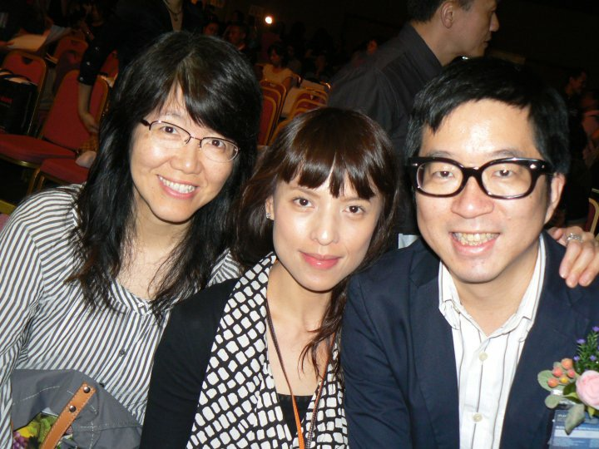
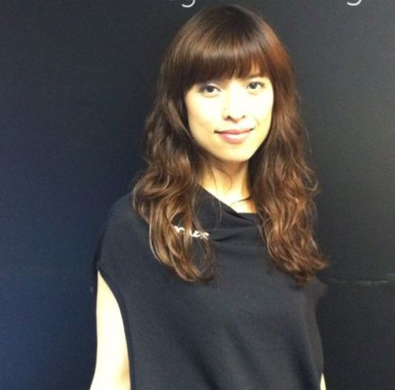
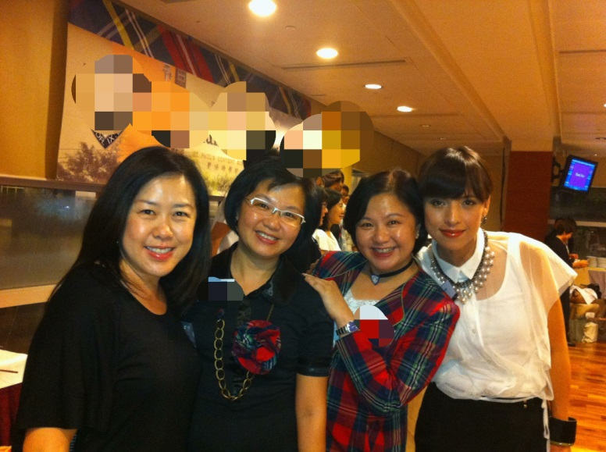
前Before
後After

Slide 8
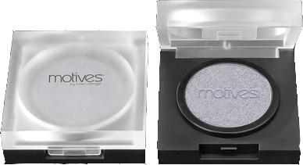
第一次零售經驗
The First Retail Experience
透過一個Motives眼影…
零售超過$2000 Motives彩妝品
Through one Motives Pressed Eye Shadow…
Lead to retail sales of >$2000 of Motives Cosmetics

Slide 9
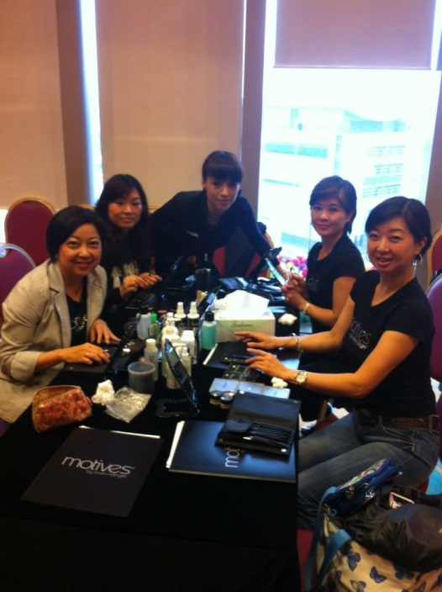
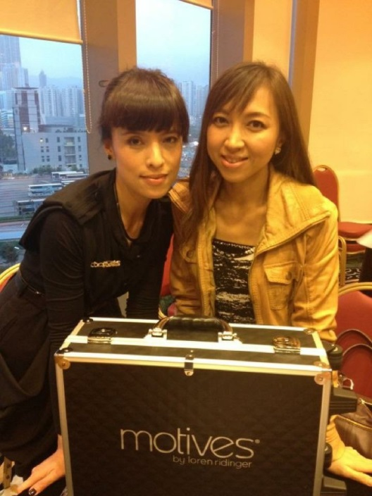
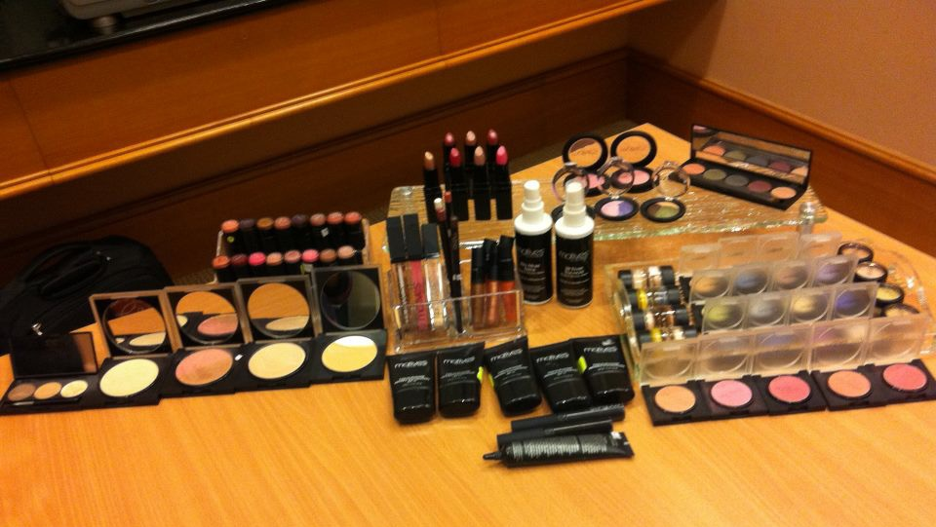
透過工作坊，建立Motives®團隊 Development of Motives® Team through Workshop
起初 Beginning…

Slide 10
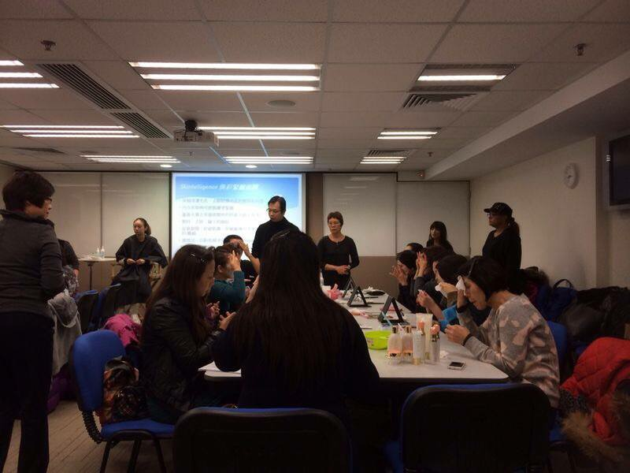
透過工作坊，建立Motives®團隊 Development of Motives® Team through Workshop
中期 Maturing stage…

Slide 11
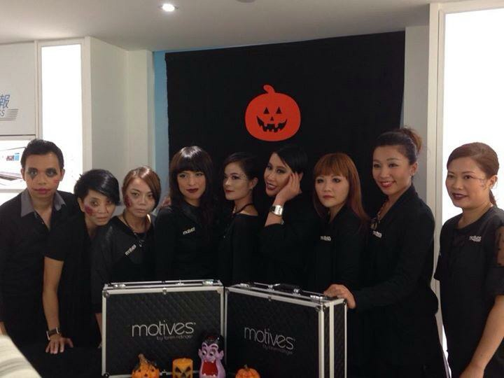
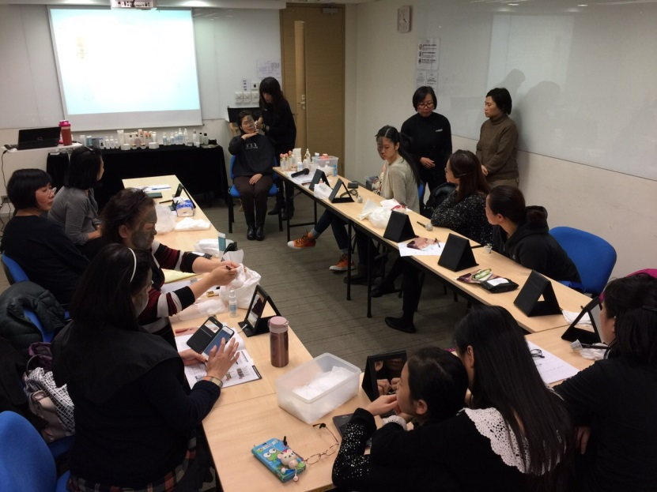
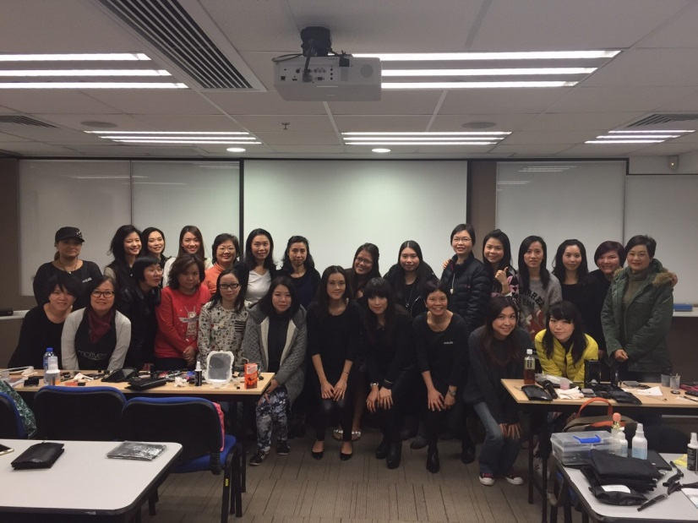
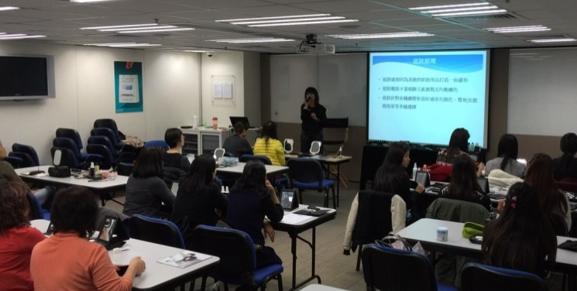
透過工作坊，建立Motives®團隊 Development of Motives® Team through Workshop
現在 Right now…

Slide 12
專業彩妝師
Makeup Professional
2013年第四季：第一位專業彩妝師加入團隊
2015年今日 ：團隊已擁有超過10位專業彩妝師
First makeup professional joined the team in the last quarter of 2013
Up till today, the team has more than 10 makeup professionals

Slide 13
團隊正增長 Positive Growth in Organization
↑30%
↑25%
零售增長
Retail Growth
人數增長
Recruitment Growth
2014年進升為總顧問經理級超連鎖™店主
Became a National Supervising Coordinator (NSC) in 2014

Slide 14
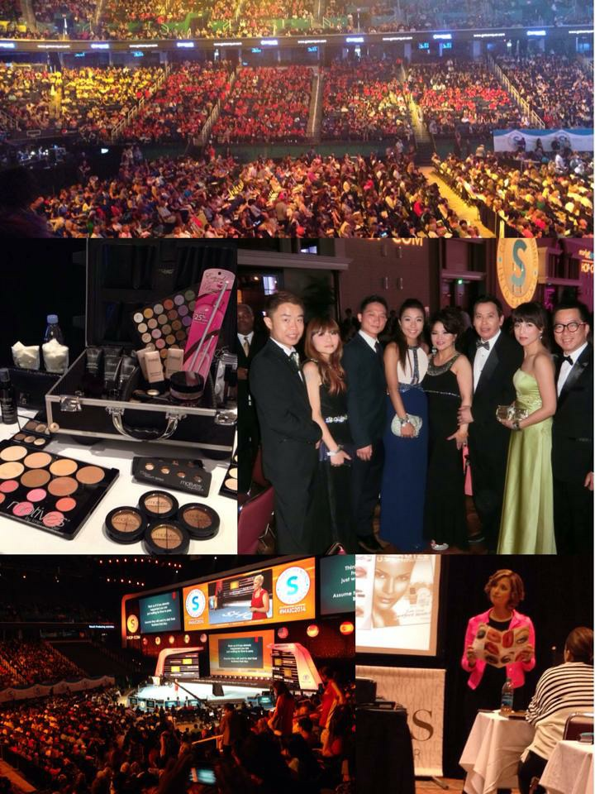
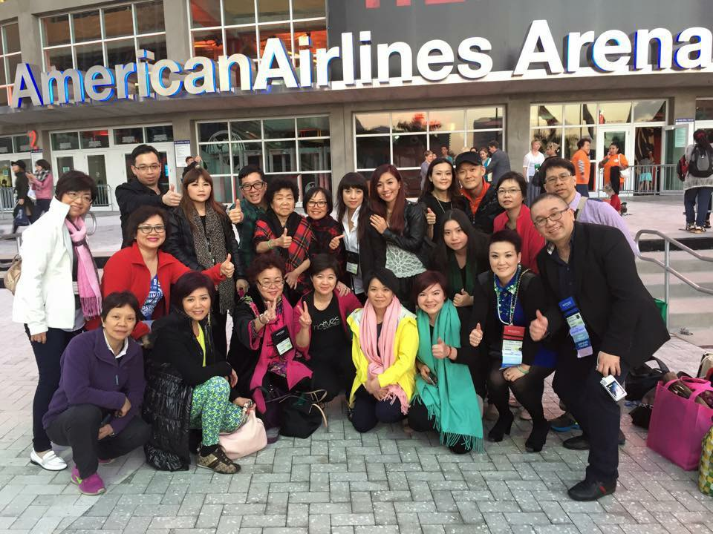

Slide 18
每日彩妝品使用量 Daily Makeup Usage
女仕平均每日使用20分鐘化妝
4/5女仕有使用化妝品
76% 選用唇彩及唇膏
65%選用睫毛液
63%選用眼影
62%選用眼線筆
38%選用眉筆
22%選用唇筆
7%選唇妝組合
86% 化妝者選用彩妝品有護膚功效
Average woman spends 20 minutes a day applying makeup
4/5 women wear makeup
76% use lip gloss and lipstick
65% report using mascara
63% report wearing eye shadow
62% use eye liner
8% use brow pencils
22% use lip pencil
7% use compact lip color
86% of makeup users have used makeup with skin care benefits in the past year

Slide 19
Motives®春夏新趨勢
Motives® Spring and Summer Collection
Angie Chou
主管經理級 Master Coordinator
四個佣金週期共賺取HK$16,100
HK$16,100 in 4 Commission weeks
本簡報中提到的收入等級純屬舉例說明，無意代表美安香港超連鎖店主的一般收入，也無意表示任何超連鎖店主皆可賺取同等收入。美安香港超連鎖店主的成功與否，取決於其在發展事業時的努力、才能與投入程度。The income levels mentioned in the following presentation are for illustration purposes only. They are not intended to represent the income of a typical Market Hong Kong UnFranchise Owner, nor are they intended to represent that any given Independent UnFranchise Owner will earn income in that amount. The success of any Market Hong Kong Independent UnFranchise Owner will depend upon the amount of hard work, talent, and dedication which he or she devotes to building his or her Market Hong Kong Business.

Slide 20
形象設計，美容及化妝導師
熱愛藝術，時裝，自7歲已開始護膚
香港設計學院修讀時裝設計
參與多個時裝表演，廣告，舞台劇，新娘化妝工作
企業儀容彩妝培訓顧問
Image designer and makeup professional
Love design and fashion. Started her skincare regimen at the age of 7
Studied fashion design at Hong Kong School of Design
Act as makeup designer for fashion shows, advertisement, drama and wedding event
Makeup
Beauty Consultant for Corporates

Slide 21
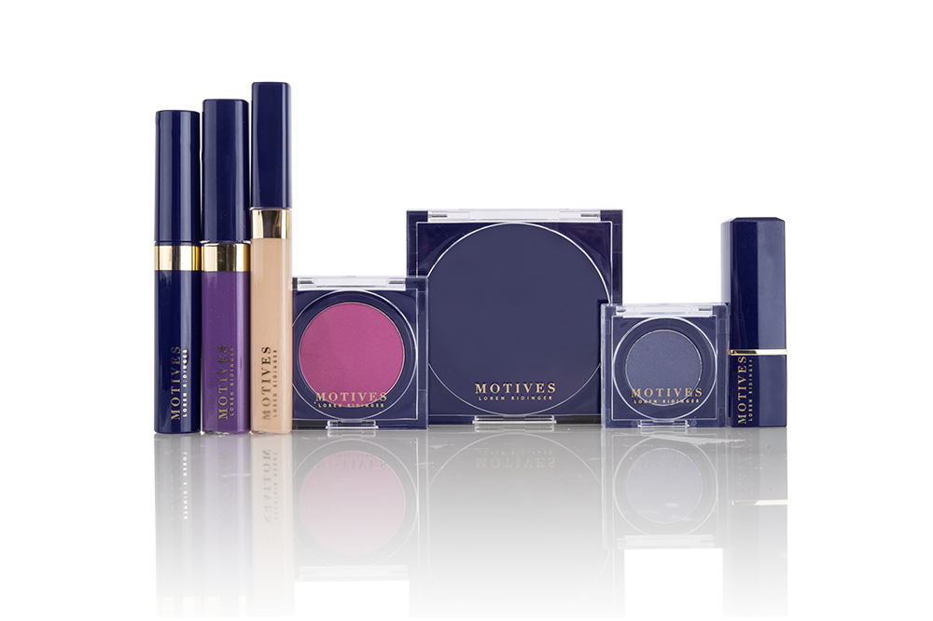

Slide 22
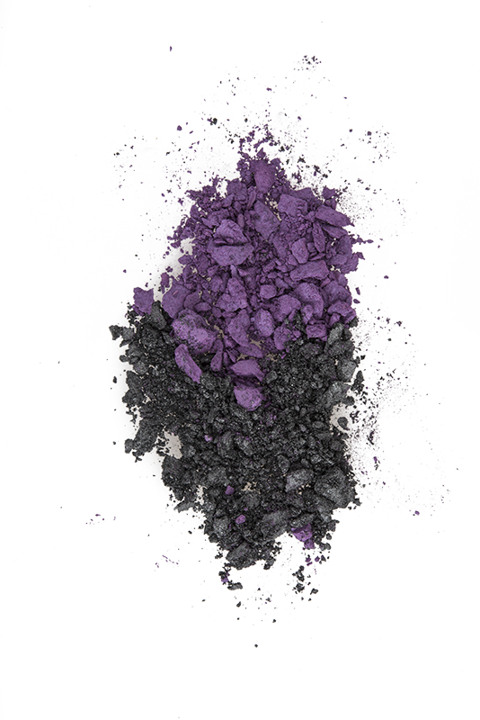
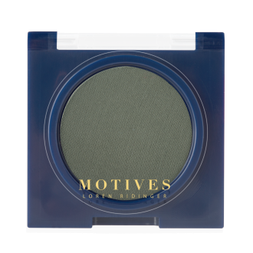
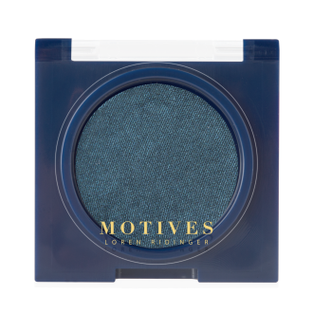
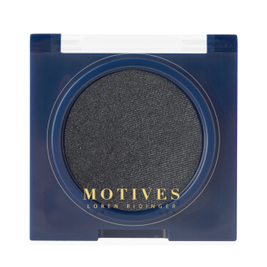
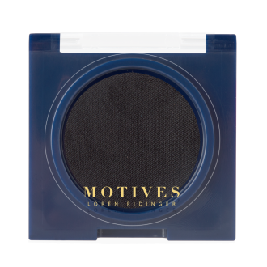
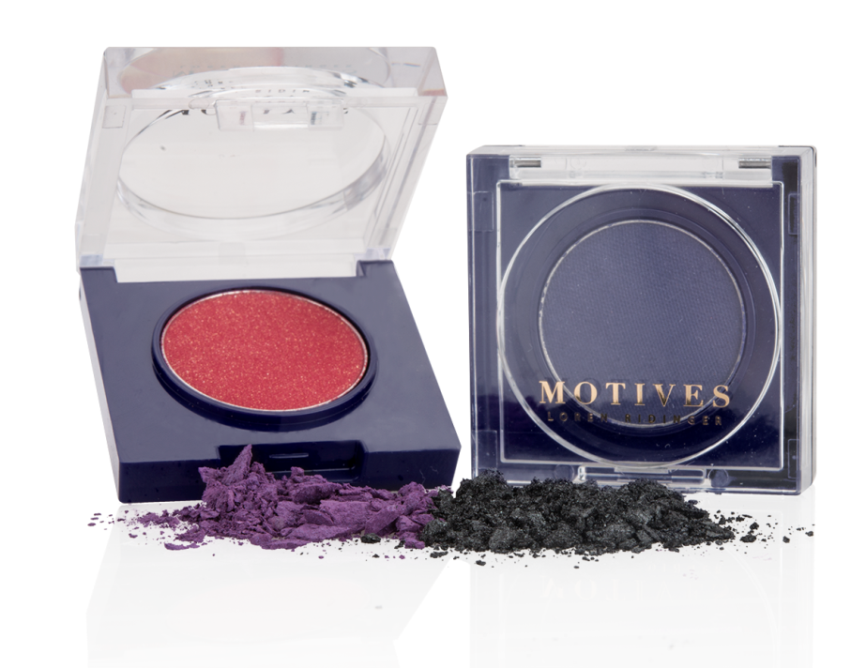
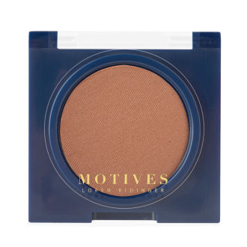
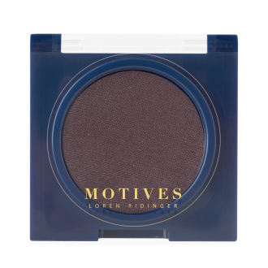
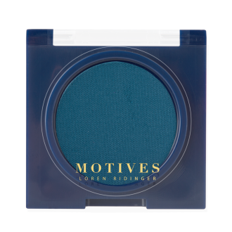
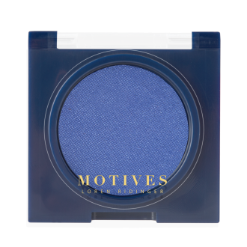
MOTIVES®眼影 PRESSED EYE SHADOW
UC: $95.00 | SR: $133.00 | BV: 8.00

Slide 23
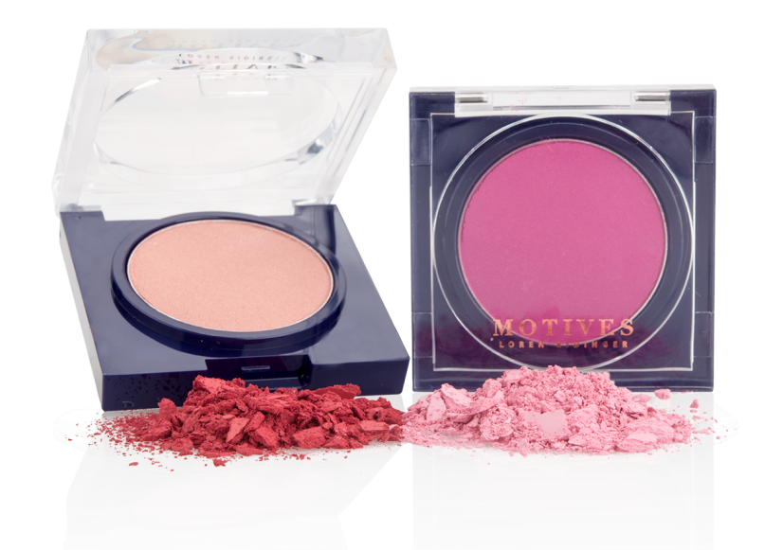
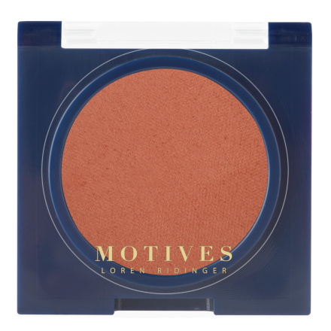
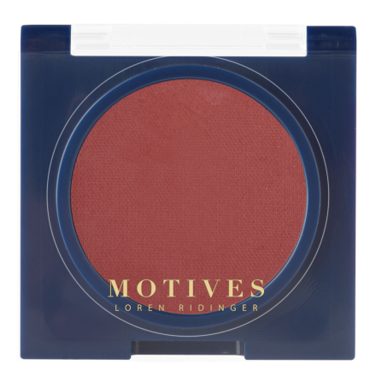
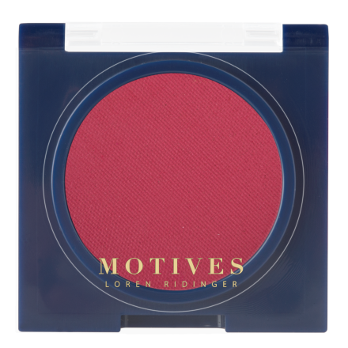
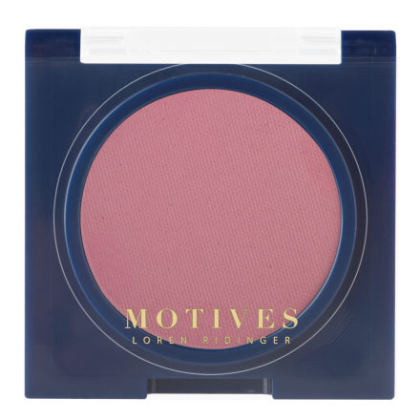
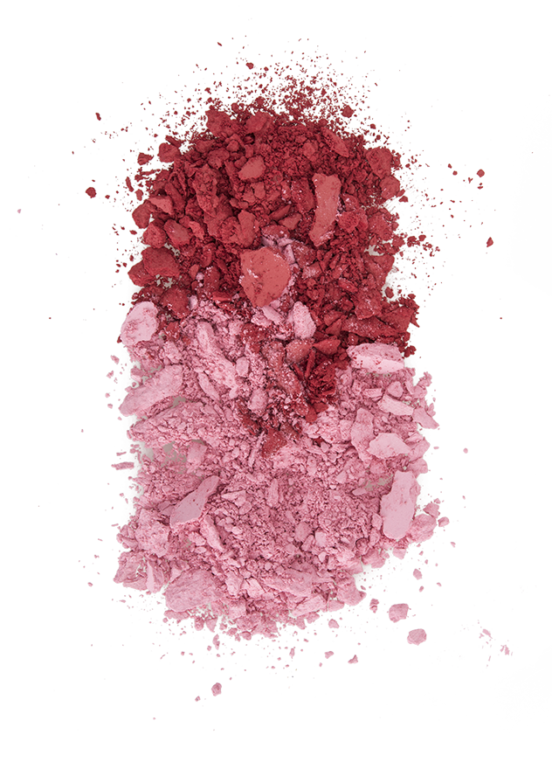
MOTIVES®胭脂 PRESSED BLUSH
UC: $110.00 | SR: $155.00 | BV: 9.75

Slide 24
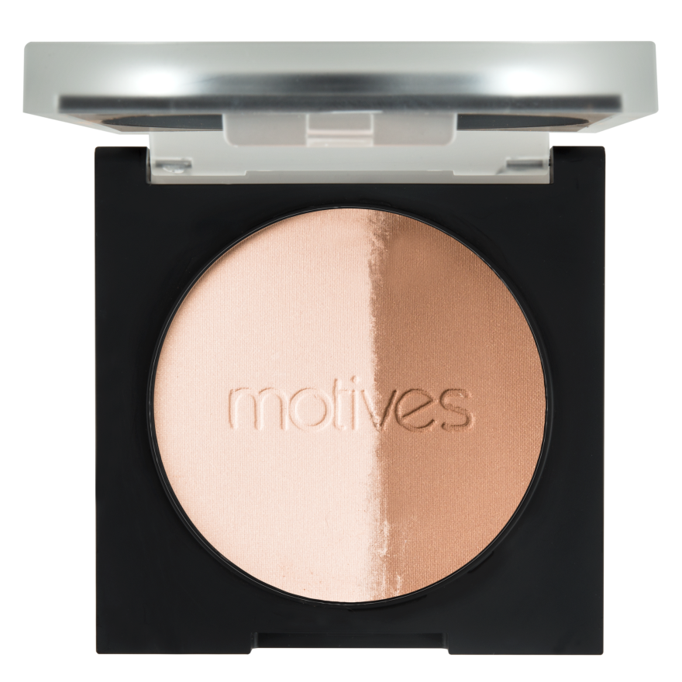
MOTIVES ®多效修容粉餅 SHAPE AND SCULPT DUO
CODE: HK100MSD
UC: $140.00
SR: $196.00
BV: 12.50

Slide 25
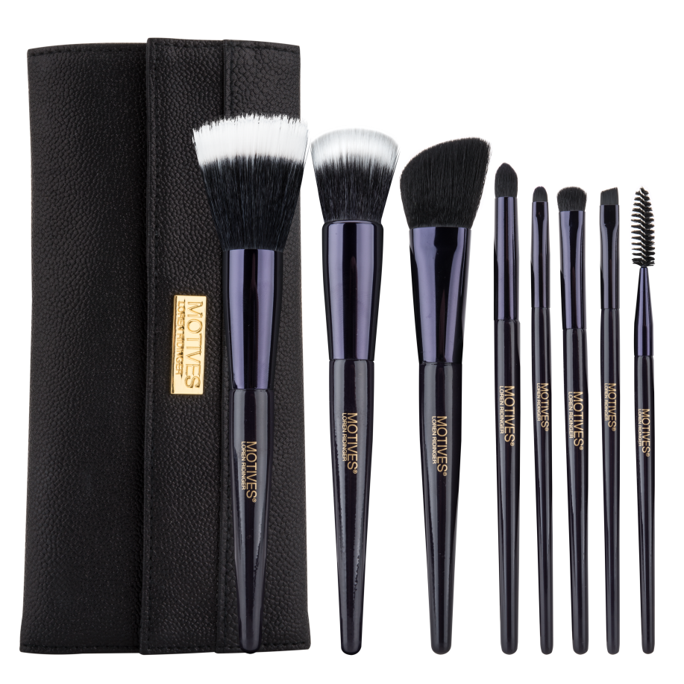
MOTIVES ®瑰麗化妝掃套裝 DELUXE BRUSH SET
CODE: HK46MBR
UC: $415.00
SR: $585.00
BV: 25.00

Slide 26
MOTIVES ®專業套裝 PROFESSIONAL MAKEUP KIT
30%
HK2015MLE | UC: HK$5,600.00 | SR: HK$7,600.00 | BV: 400

Slide 27
2015春夏新趨勢 SPRING & SUMMER TRENDS

Slide 28
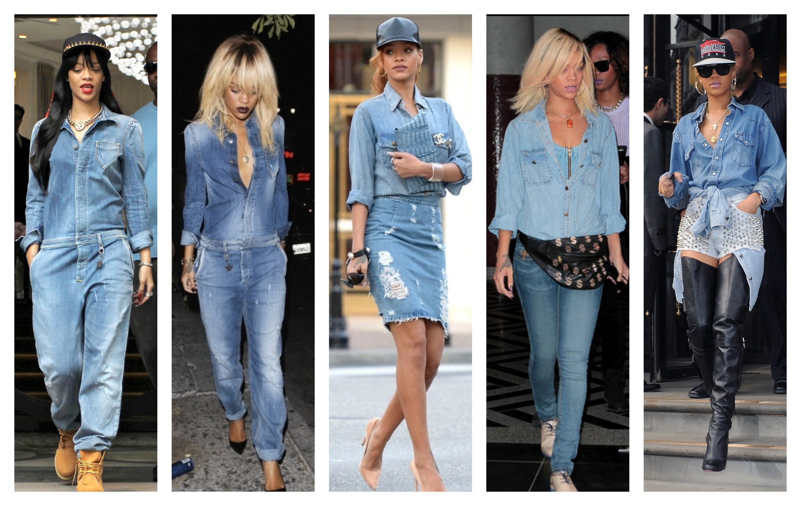

Slide 29
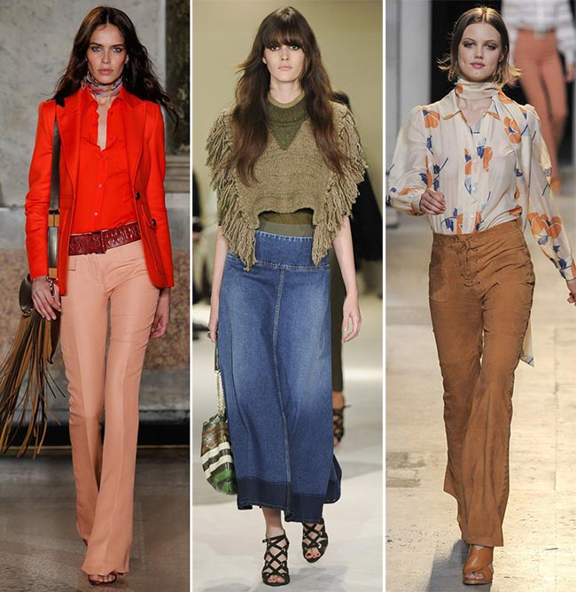
2015 SPRING & SUMMER

Slide 30
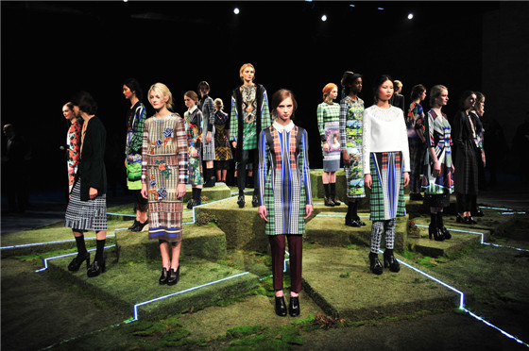

Slide 32
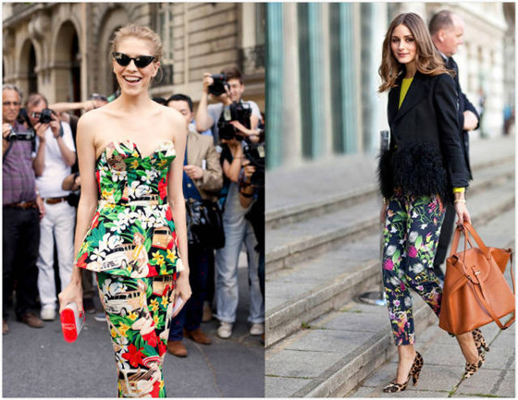

Slide 33
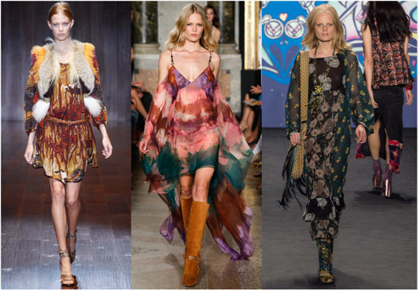

Slide 34
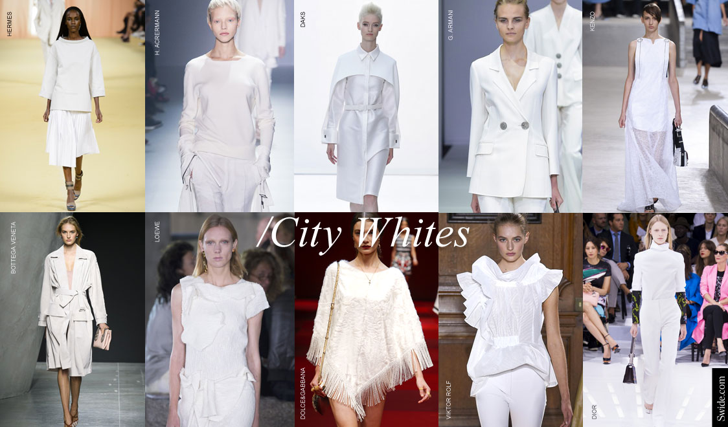

Slide 37
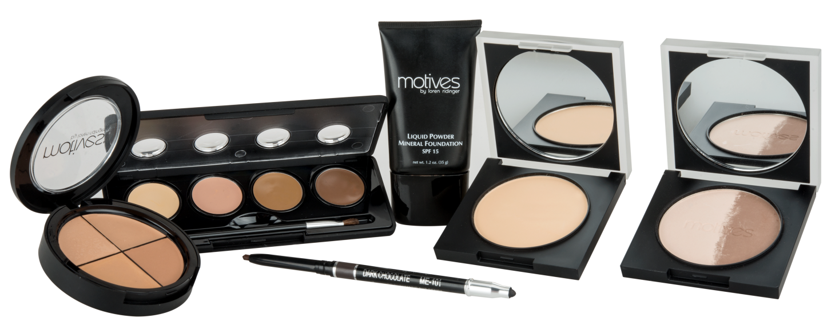

Slide 38
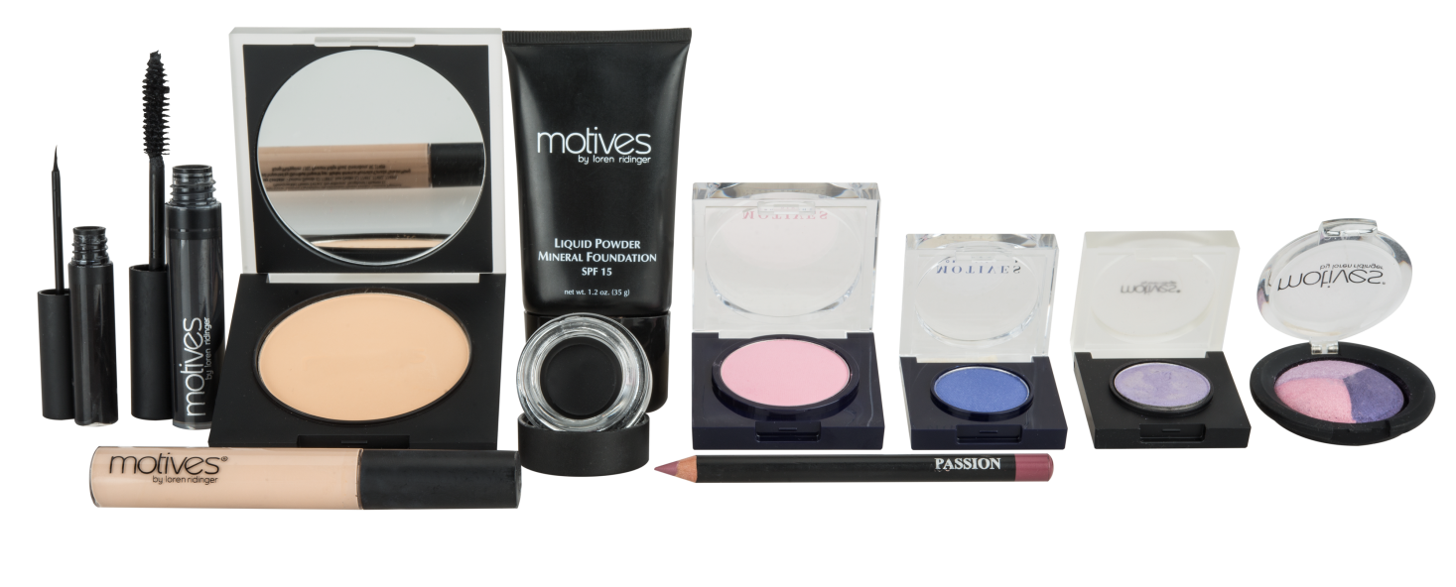

Slide 40
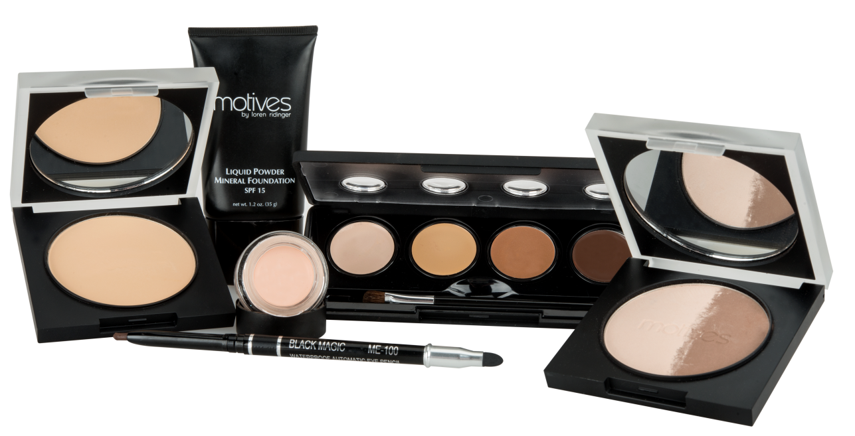

Slide 41
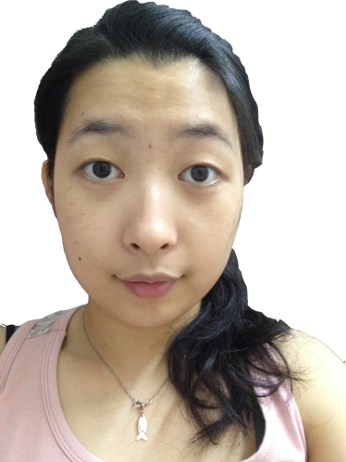

Slide 42
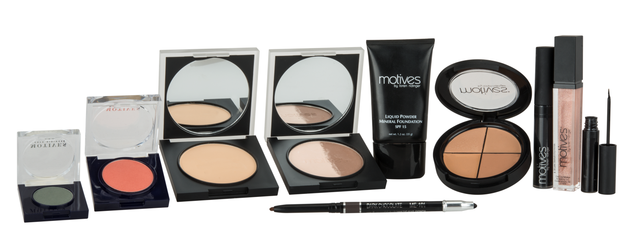

Slide 44
MOTIVES ®授証訓練
CERTIFIED TRAINING
日期：6月13及14日（六及日）
地點：美安生活廊
DATE: JUNE 13 & 14 (SAT. & SUN)
VENUE: MHK SHOWCASE
Lisa Martin
Motives ®總監－超連鎖™ 店主培訓
Director of Field Development

